Slide 1
Chapter 2
Android Components and Resource handling

Slide 2
Outline
Context
Activity
Intent
Service
Broadcast Receiver
String

Slide 3
Outline
Color
Drawable
Theme
Prepare Application for Localization

Slide 4
Android Components
An android component is simply a piece of code that has a well defined life cycle e.g. Activity, Receiver, Service etc.
The core building blocks or fundamental components of android are activities, views, intents, services, content providers, fragments and AndroidManifest. xml.

Slide 5
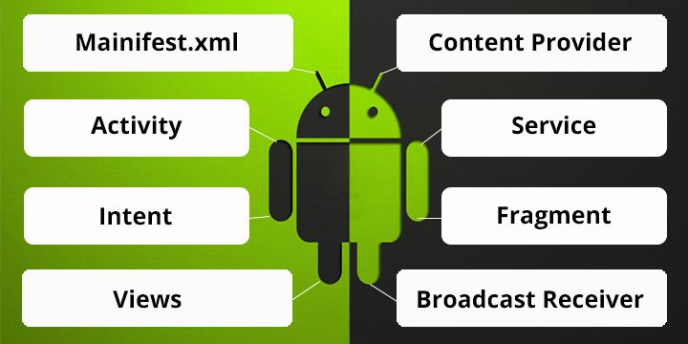
Android Components
Activities
Services
Content Providers
Broadcast Receivers
Intents
Widgets
Notification

Slide 6
Context
The Contex class(android.content.context) is a fundamental building block of any android application and provides access to application-wide features such as the application’s private files and device resources, as well as system-wide services.
The application wide Context object is instantiated as an Application object(android.app.Application).

Slide 7
Activity
Activity class is the core of any Android Application.
You define and implement Activity class for each screen in your application.
For example a simple game application might have the following five activities:
A starting screen: displays the application name and version
A main menu screen: users choose what they want to do within the application.
A game play screen
A high score screen
A help/about screen

Slide 8
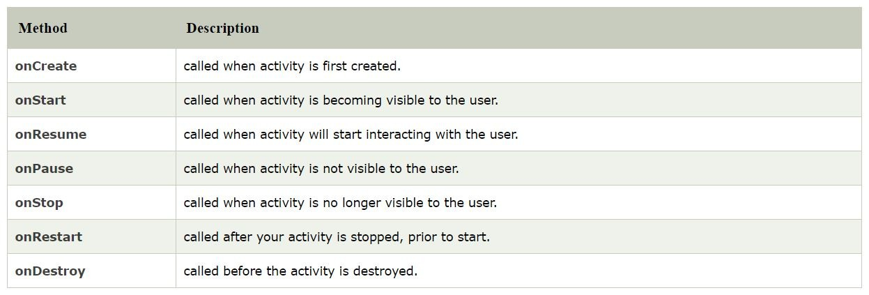
Activity

Slide 9
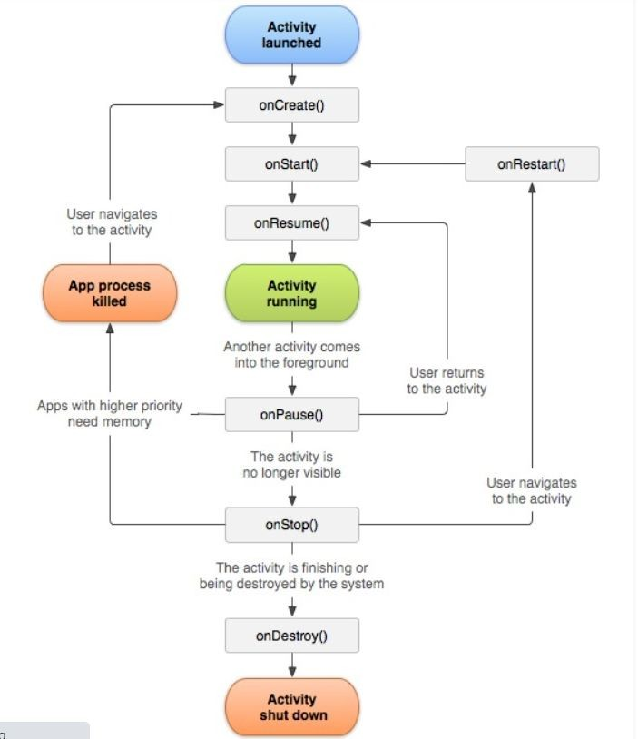
Activity

Slide 10
Activity
Running State
An activity is in the running state if it’s shown in the foreground of the users’ screen
When an Activity is in active state, it means it is active and running.
It is visible to the user and the user is able to interact with it.
Android Runtime treats the Activity in this state with the highest priority and never tries to kill it.

Slide 11
Activity
Paused State
An activity being in this state means that the user can still see the Activity in the background such as behind a transparent window or a dialog box but it is partially visible.
The user cannot interact with the Activity until he/she is done with the current view.
Android Runtime usually does not kill an Activity in this state but may do so in an extreme case of resource crunch.

Slide 12
Activity
Resumed State
It is when an activity goes from the paused state to the foreground that is an active state

Slide 13
Activity
Stopped State:
When a new Activity is started on top of the current one or when a user hits the Home key, the activity is brought to Stopped state.
The activity in this state is invisible, but it is not destroyed.
Android Runtime may kill such an Activity in case of resource crunch.

Slide 14
Intent
An Intent is a messaging object that allows components (such as activities, services, and broadcast receivers) to communicate with each other.
Intents are primarily used to start new activities, pass data, invoke system services, or broadcast messages across the system.
Android intents are mainly used to:
Start the service
Launch an activity
Display a web page
Display a list of contacts
Broadcast a message
Dial a phone call etc.
:

Slide 15
Intent
Types of Intent:
Explicit Intent: Used when you explicitly specify the target component (e.g., starting a specific activity or service).
Example: Navigating from one activity to another within the same application.
Implicit Intent: Used when you don’t specify the target component directly. Instead, you declare an action, and the system determines the appropriate component (e.g., opening a web page or sharing content).
Example: Opening a web page in the browser.

Slide 16
Intent
To implement activities in our application, we need to register them in the Manifest file. For the activities to work properly, we must manage their lifecycle properly.
Declare Activities
Declare Intent Filters
Declare Permission

Slide 17
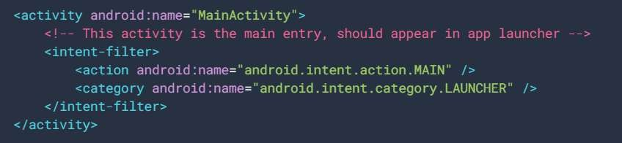
Intent

Slide 18

Service
A service is a component that runs in the background, it acts as an invisible worker of our application. It keeps updating data sources and activities. It also broadcasts intents and performs tasks when applications are not active. An example of service is we can surf the internet or use any other application while listening to music.
To execute services, extend the Services class in your sub-class:

Slide 19
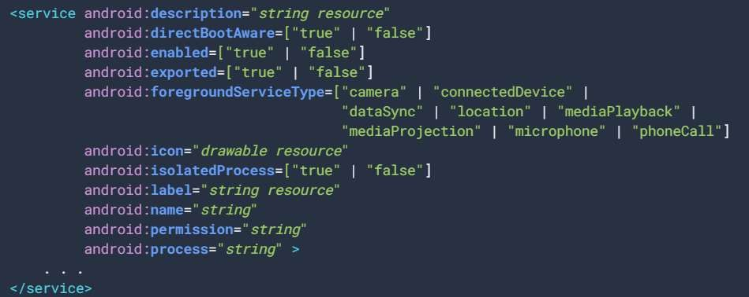
Service
Registering Services in Android Manifest

Slide 20
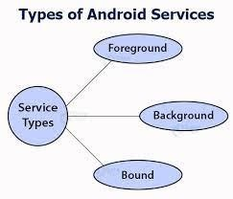
Service

Slide 21
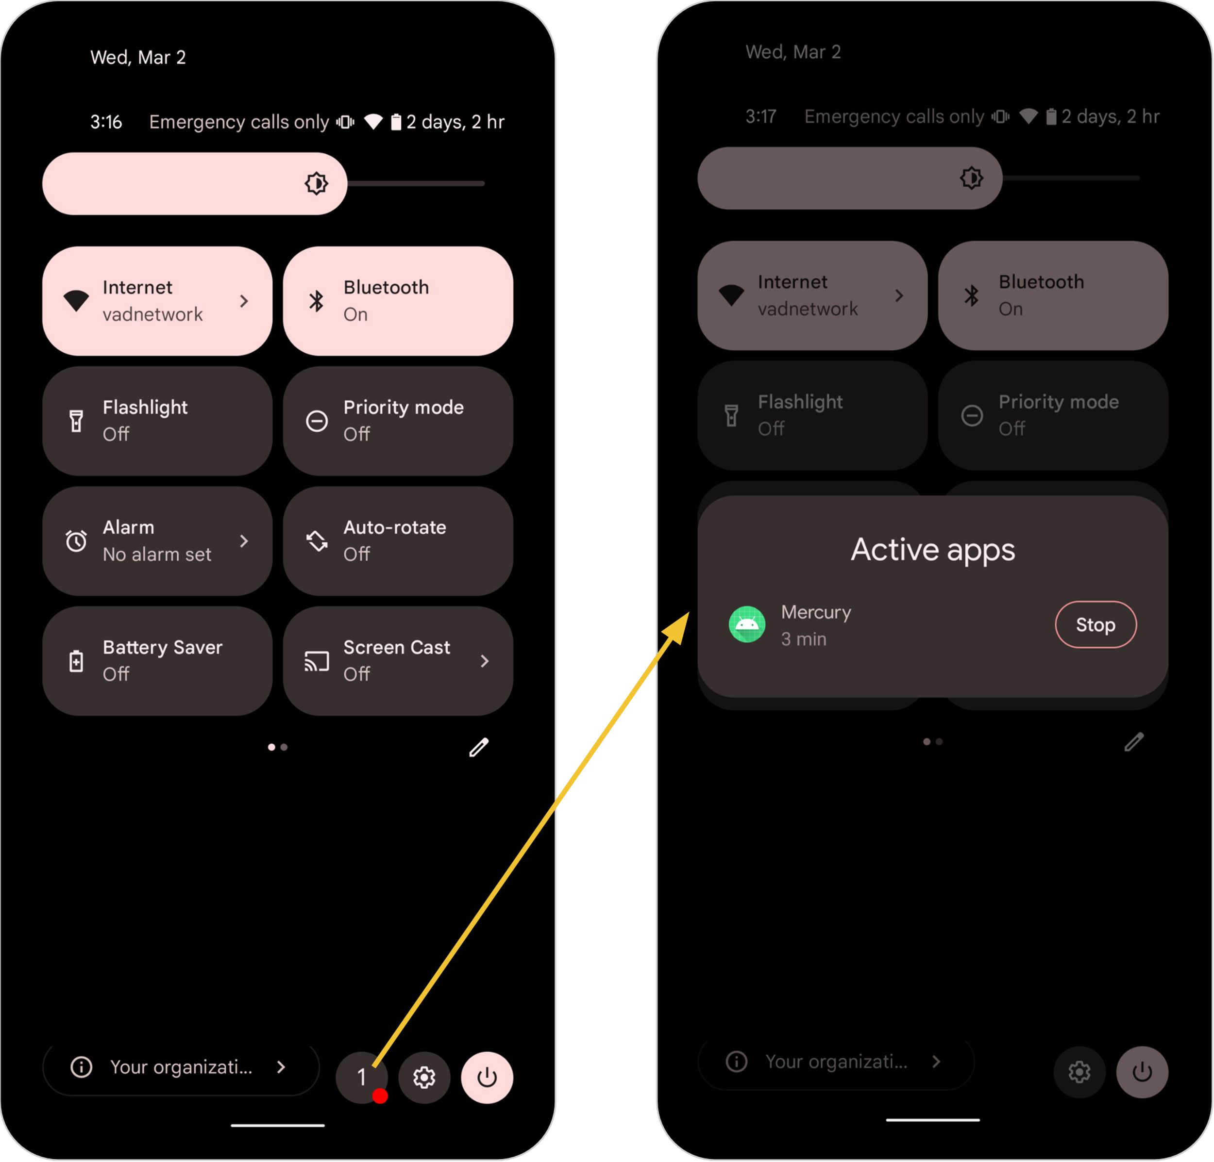
Service – Foreground services
Services that notify the user about its ongoing operations are termed as Foreground Services.
Users can interact with the service by the notifications provided about the ongoing task. Such as in downloading a file, the user can keep track of the progress in downloading and can also pause and resume the process.
Foreground services are those services that are visible to the users.
The users can interact with them at ease and track what’s happening.
These services continue to run even when users are using other applications
The perfect example of this is Music Player and Downloading.

Slide 22
Service – background services
These services run in the background, such that the user can’t see or access them.
These are the tasks that don’t need the user to know them.
Background services do not require any user intervention.
These services do not notify the user about ongoing background tasks and users also cannot access them.
The process like schedule syncing of data or storing of data fall under this service.

Slide 23
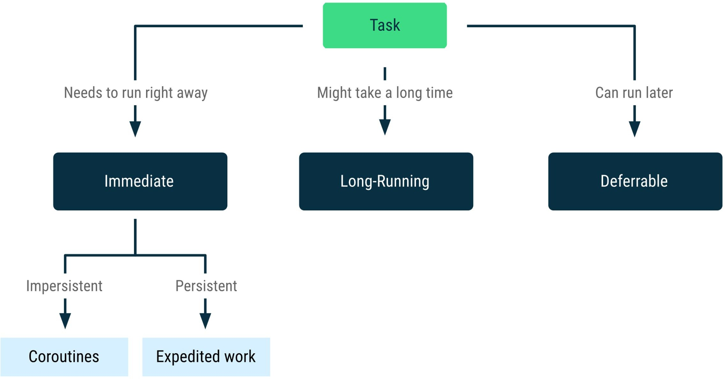
Service – background services
Background work falls into one of three primary categories:
Immediate:
Needs to execute right away and complete soon.
Long Running:
May take some time to complete.
Deferrable:
Does not need to run right away
Likewise, background work in each of these three categories can be either persistent or impersistent:
Persistent work:
Remains scheduled through app restarts and device reboots.
Impersistent work:
No longer scheduled after the process ends.

Slide 24
Service – background services
Immediate Working
Immediate work includes tasks that must be completed right away. These are tasks that are important to the user or that you cannot otherwise schedule for later execution. They are significant enough that they may need to be scheduled for immediate execution even if the app is closed or the device restarted.
Eg:
A data source must be used to load data into an app. Making such a request on the main thread, on the other hand, will block it and cause UI jank. Instead, the app executes the request in a coroutine outside of the main thread.

Slide 25
Service – background services
Long Running Work
A long running task is a task that requires more than 30 seconds to complete and involves a large amount of data.
Work is long running if it is likely to take more than ten minutes to complete.
It allows you to handle such tasks using a long Eg:
An apps needs to download a large file which you cannot junk it creates a long running work and computing the download.

Slide 26
Service - Bound Services
Bound service runs as long as some other application component is bound to it. Many components can bind to one service at a time, but once they all unbind, the service will destroy.

Slide 27
Service
Android services life cycle can have two forms of services and they follow two paths, that are
Started Service
A service becomes started only when an application component calls startService(). It performs a single operation and doesn’t return any result to the caller. Once this service starts, it runs in the background even if the component that created it destroys. This service can be stopped only in one of the two cases
By using the stopService() method.
By stopping itself using the stopSelf() method.

Slide 28
Service
2. Bounded Service
A service is bound only if an application component binds to it using bindService(). It gives a client-server relation that lets the components interact with the service. The components can send requests to services and get results.
This service runs in the background as long as another application is bound to it. Or it can be unbound according to our requirement by using the unbindService() method.

Slide 29
Content Provider
Content Providers are an important component of Android.
They handle the access to the central repository and supply data from one application to another on request.
This task of handling is done by methods of ContentResolver class. So, content providers can store data in various ways such as files, database or over the internet.
It acts as the same as database and also we can query it to add, delete, insert or update the data.
It can be understood that a content provider hides the database details and also, it lets an application share data among other applications. Content providers are not limited to texts, but also contains images and videos as well.

Slide 30
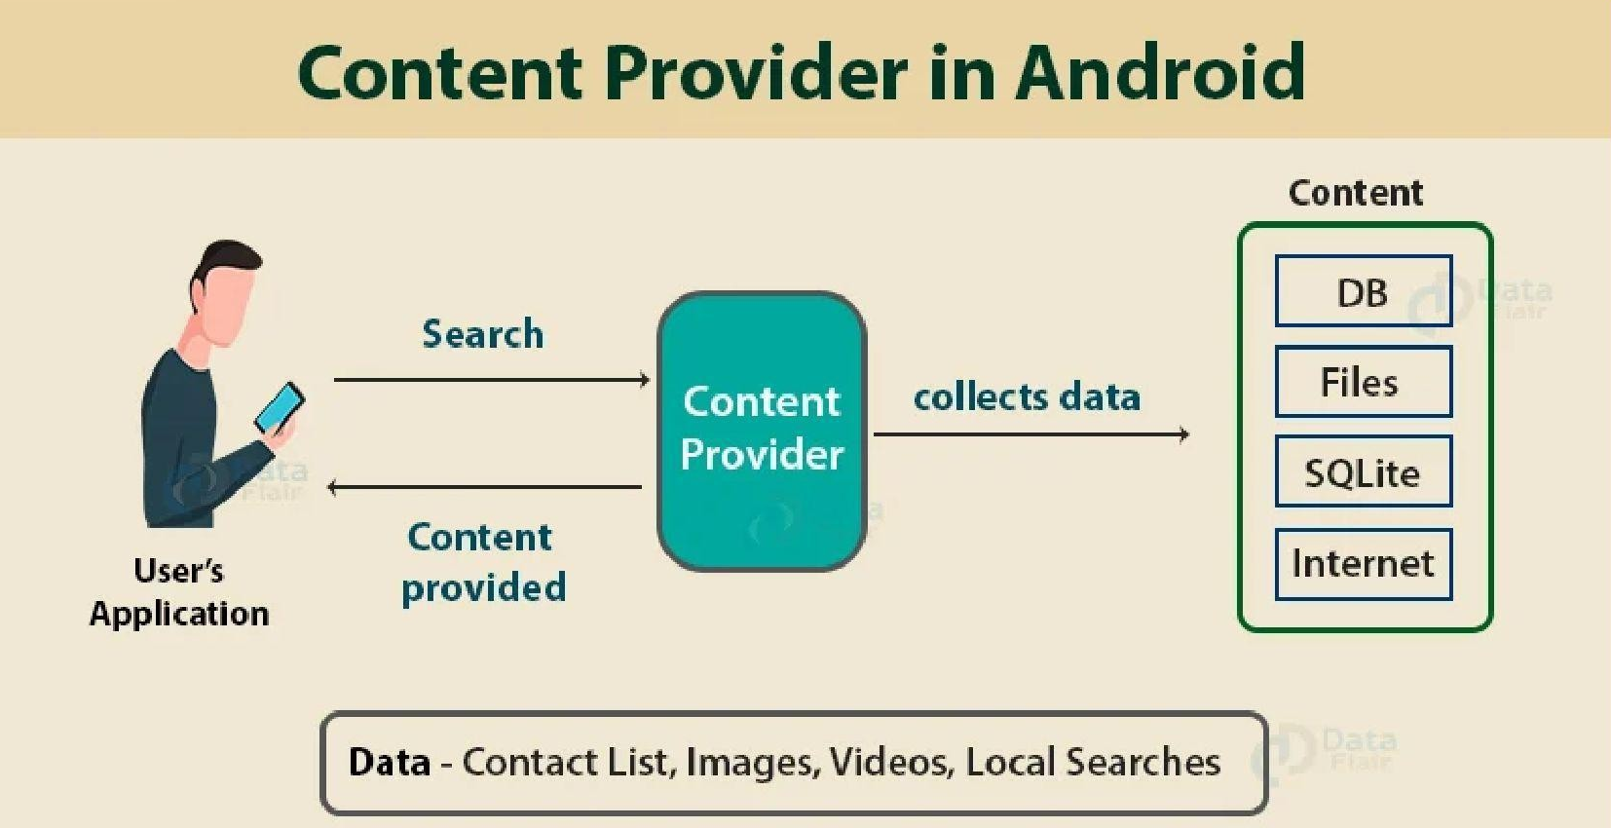
Content Provider

Slide 31
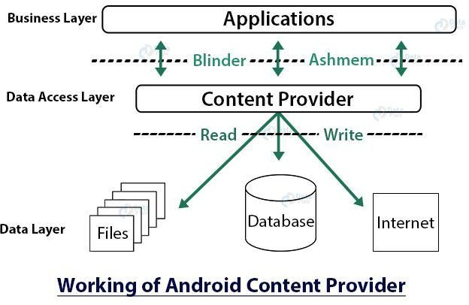
Content Provider

Slide 32
Content Provider
We need to use the ContentResolver object in our application, in order to communicate with the content providers for data access.
Now to enable communication between the user interface and ContentResolver, we use another object, CursorLoader to run query asynchronously. This CursorLoader will be called using Activity/Fragment of the application.
Then, the content provider receives the query from the client and executes and returns the result.

Slide 33
Content Provider
onCreate() – This method in Android initializes the provider as soon as the receiver is created.
query() – It receives a request in the form of a query from the user and responds with a cursor in Android.
insert() – This method is used to insert the data into our content provider.
update() – This method is used to update existing data in a row and return the updated row data.
delete() – This method deletes existing data from the content provider.
getType()– It returns the Multipurpose Internet Mail Extension type of data to the given Content URI.

Slide 34

Broadcast Receiver
Broadcast Receiver is a component that responds to broadcast messages from another application or the same system. It can also deliver broadcasts to applications that are not running. For example – notify the user that the battery is low. Android developers can use broadcast messages in the application or outside the normal flow.
To implement this, extend BroadcastReceiver to your receiver:

Slide 35
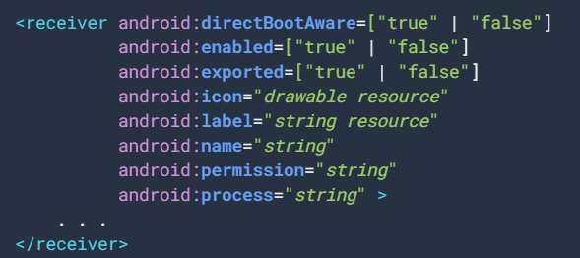
Broadcast Receiver
Registering Broadcast Receiver in Android Manifest

Slide 36
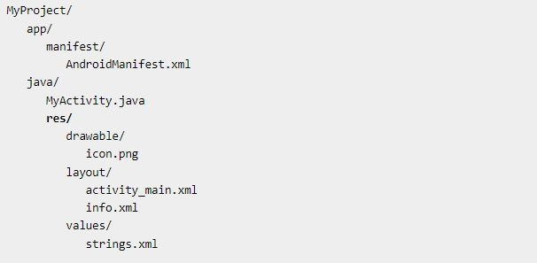
Resource (res folder structure)

Slide 37
String
One of the most important as well as widely used values file is the strings.xml due to its applicability in the Android project. Basic function of the strings.xml is to define the strings in one file so that it is easy to use same string in different positions in the android project plus it makes the project looks less messy. We can also define an array in this file as well.

Slide 38

String

Slide 39
color
The colors.xml is an XML file that is used to store the colors for the resources. An Android project contains 3 essential colors namely:
colorPrimary
colorPrimaryDark
colorAccent
These colors are used in some predefined resources of the Android studio as well. These colors need to be set opaque otherwise it could result in some exceptions to arise.

Slide 40
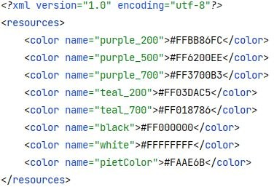
color

Slide 41
drawable
The resource folder is the most important folder because it contains all the non-code sources like images, XML layouts, UI strings for the android application.
Among them, the drawable folder contains the different types of images used for the development of the application. We need to add all the images to the drawable folder for the application development. Images are used in android applications to provide more user-friendly behavior & functionality.

Slide 42
Styles
Another important file in the values folder is the styles.xml where all the themes of the Android project are defined. The base theme is given by default having the option to customize or make changes to the customized theme as well. Every theme has a parent attribute which defines the base of the theme. There are a lot of options to choose from depending on the need of the Android project.

Slide 43
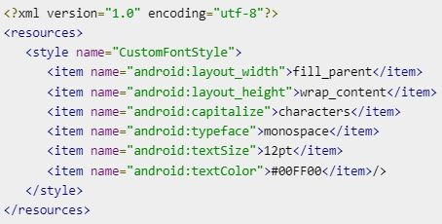
Styles

Slide 44
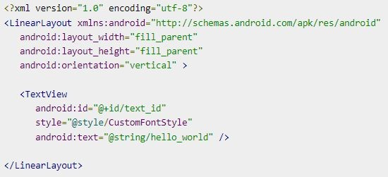
Styles – Using styles

Slide 45
Theme
A theme is nothing but an Android style applied to an entire Activity or application, rather than an individual View.
Thus, when a style is applied as a theme, every View in the Activity or application will apply each style property that it supports. For example, you can apply the same CustomFontStyle style as a theme for an Activity and then all text inside that Activity will have green monospace font.
To set a theme for all the activities of your application, open the AndroidManifest.xml file and edit the <application> tag to include the android:theme attribute with the style name. For example −

Slide 46
Localization: Preparing an Application for Localization
Localization is the process of adapting your application to support multiple languages and regions to reach a global audience.
This involves translating text, formatting dates, times, numbers, currencies, and other region-specific content.
In Android, localization is achieved by organizing application resources (like strings, layouts, images) into region-specific directories and allowing the system to load the appropriate resources based on the user's language and locale settings.

Slide 47
Steps to Prepare an Android Application for Localization
1. Use Resource Files for Text (Avoid Hardcoding)All user-visible strings should be defined in the res/values/strings.xml file. Avoid hardcoding strings directly in the code or layout files.
XML code
<!-- res/values/strings.xml -->
<string name="app_name">My Application</string>
<string name="welcome_message">Welcome to My Application</string>

Slide 48
Steps to Prepare an Android Application for Localization
Access these strings in
Java code
String welcomeMessage = getString(R.string.welcome_message);
XML code
<TextView
android:text="@string/welcome_message"
android:layout_width="wrap_content"
android:layout_height="wrap_content" />

Slide 49
Steps to Prepare an Android Application for Localization
2. Create Language-Specific Resource FilesAndroid uses a flexible resource structure to support multiple languages.
For each language, create a separate strings.xml file in a language-specific folder.
Default language (English): res/values/strings.xml
<string name="welcome_message">Welcome</string>

Slide 50
Steps to Prepare an Android Application for Localization
French localization: res/values-fr/strings.xml
<string name="welcome_message">Bienvenue</string>
Spanish localization: res/values-es/strings.xml
<string name="welcome_message">Bienvenido</string>
When a user’s device is set to a specific language, Android automatically loads the corresponding strings.xml file.

Slide 51
Steps to Prepare an Android Application for Localization
3. Organize Region-Specific Resources Localization isn't just about translating text. Images, layouts, or other resources might also need adaptation for different regions.
Example of localized resources:
Default layout: res/layout/activity_main.xml
Arabic layout (Right-to-Left): res/layout-ar/activity_main.xml
Default drawable: res/drawable/logo.png
Chinese drawable: res/drawable-zh/logo.png

Slide 52
Steps to Prepare an Android Application for Localization
4. Localize Date, Time, and Numbers
Android provides utilities to format dates, times, and numbers in a localized manner using the user's locale settings.
Example of localized date and time formatting:
Locale currentLocale = Locale.getDefault();
DateFormat dateFormat = DateFormat.getDateInstance(DateFormat.LONG, currentLocale);
String formattedDate = dateFormat.format(new Date());

Slide 53
Steps to Prepare an Android Application for Localization
Example of localized currency formatting:
NumberFormat currencyFormat = NumberFormat.getCurrencyInstance(currentLocale);
String formattedCurrency = currencyFormat.format(1234.56);

Slide 54
Steps to Prepare an Android Application for Localization
5. Test LocalizationUse Android's built-in Emulator or a real device to test localization by switching the language in device settings:
Settings > System > Languages & Input > Languages.
Simulate Locale Changes:
Use Android Studio's Layout Editor to preview layouts in different locales.
Go to Design View > Tools > Preview Locale.

Slide 55
Benefits of Localization
Wider Audience: Reach users from different countries and cultures.
Improved User Experience: Users feel more comfortable using apps in their native language.
Higher Engagement: Users are more likely to engage and spend time in apps tailored to their region.

